Slide 1
Distributed SDN Control: Survey, Taxonomy, and Challenges: Section 4-6
By: Jordan Donovan

Slide 2
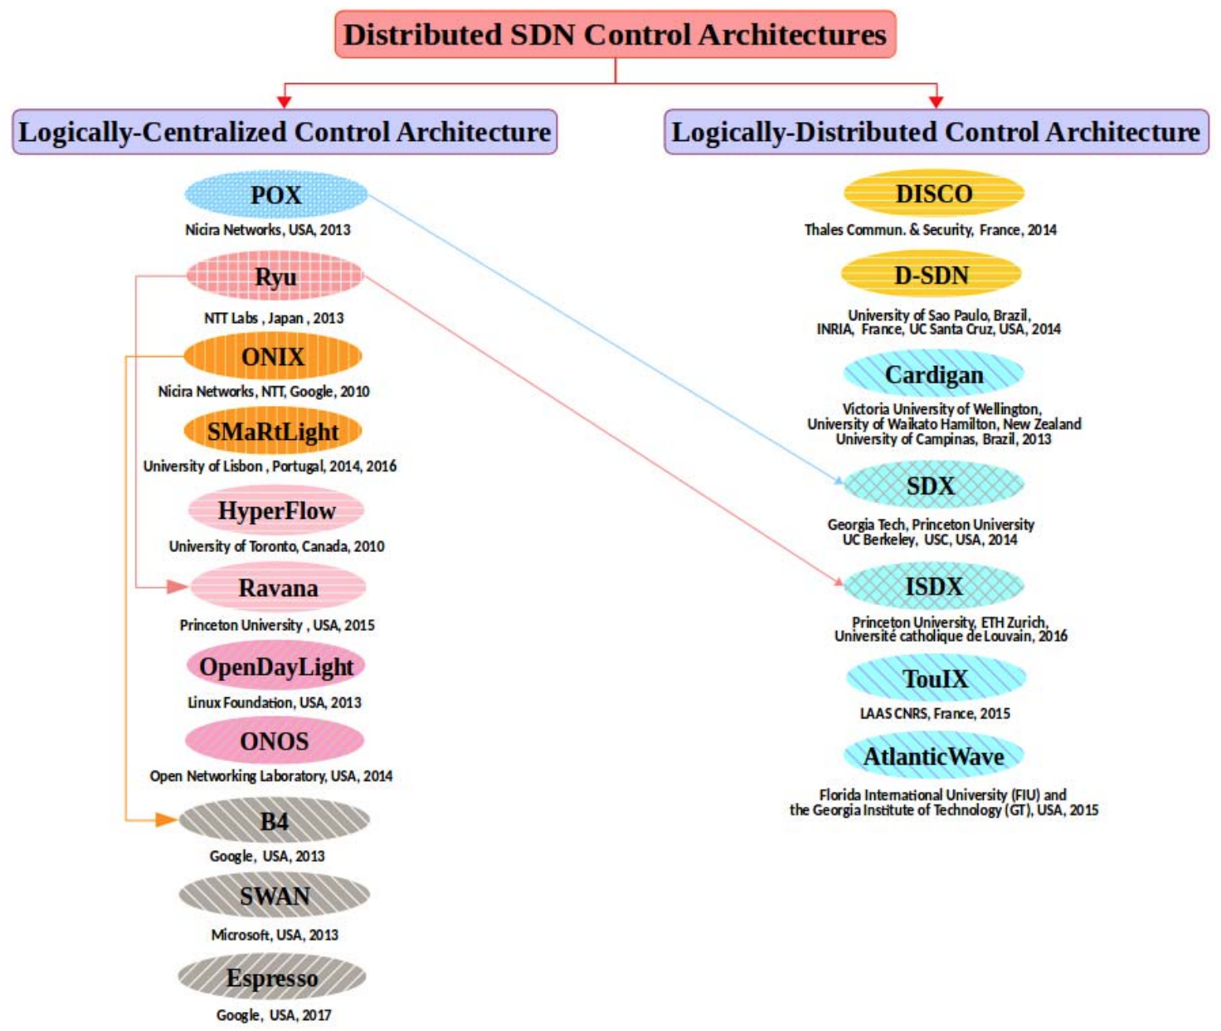
Logical Classification of Distributed SDN Control Plane Architecture
Logically centralized SDN control
Onix and SMaRtLight
Hyperflow and Ravana
ONOS and OpenDayLight
B4 and SWAN
Logically distributed SDN control
DISCO and D-SDN
SDX-Based Controllers
Notes:
Logically centralized SDN control
Onix and SMaRtLight (both use state replication for controller state redundancy)
Onix is for large production networks and provides several tools
Simple general-purpose API
Central network information base abstraction
Standard state distribution primitives for easing implementation of network applications
Onix is beneficial in providing
Programmatic framework for the flexible development of control applications with tradeoffs between performance and state consistency
SMaRtLight is a fault-tolerant logically-centralized Master-Slave SDN controller platform where a single controller is in charge of all network decisions
It contains replicas for this main controller for fault-tolerance that are kept consistent with a shared data store managed by an implementation of Replicated State Machine
Is mostly used for small to medium-sized networks for fault-tolerance, consistency, and acceptable performance levels
Hyperflow and Ravana (both use event replication for state redundancy)
Hyperflow is an extension of NOX into a distributed event-based control plane. Each NOX-based controller manages a subset of OpenFlow network switches
It uses an event-propagation publish/subscribe mechanism for maintaining the global-wide network view
Hyperflow requires minor modifications to applications, is eventually consistent, and favors availability
Ravana is a fault-tolerant platform that not only ensures controller state but also switch state consistency
Event-processing cycle is handled as a transaction that follows strict properties
Follows Replicated State Machine approach but includes switch state consistency on top of it
Performance suffers some due to the guarantee of correctness for a logically centralized controller
If this correctness is relaxed significant performance improvements can be had
ONOS and OpenDayLight (both offer community-driven, open-source frameworks and provide full functionalities of Network Operating Systems)
ONOS is targeted toward scalability, high availability, and performance including high level Northbound abstraction (global network view and application intent framework), supporting multiple protocols, and offering state dissemination mechanisms similar to Onix and Hyperflow to achieve consistency.
Offers consistentMap tool and eventually consistent map tool allowing different levels of consistency
The eventually consistent method uses optimistic replication based on gossip-based anti-entropy protocol
The strong consistency method uses RAFT (using an elected leader controller)
OpenDayLight is a generic and general purpose framework made to accommodate a wide variety of applications and use cases in different domains
Main focus was to accelerate integration of SDN into legacy network environments
Latest releases of ODL offer distributed SDN controller architecture with strong consistency using RAFT
B4 and SWAN
Google’s B4 uses logical centralization to deploy traffic engineering (TE) as well as shortest-path routing for increase network efficiency and performance
The main task of the TE server is to optimize bandwidth among competing applications
Is is assumed that there is a specific consistency model used by the SDN gateway, but little information has been given on this
SWAN is Microsoft’s intr-domain software-driven WAN deployment that also uses TE in conjunction with logical centralization to improve efficiency, reliability, and fairness of their inter-DC WAN
Not much information has been given on this, much like Google’s B4
Logically Distributed SDN control will help with controlling heterogenous networks involving multiple autonomous systems under different administrative authorities
Disco and D-SDN
Disco operates in a multi-domain, heterogenous environments (specifically WAN and overlay networks)
Biggest contribution is the separation between intra-domain and inter-domain features of the control plane
Intra-domain modules involve the main functions of the controller
Inter-domain modules involve message oriented communication between neighbor domain controllers
Main advantage is to adapt it to large scales networks with different ASes such as the Internet
There are some drawbacks to Disco
Static non-evolving decomposition of the network into several independent entities
Network performance optimization leads to local optima instead of global optimum
In Disco one controller is in charge of one domain but ASes may be too large for one controller
Disco does not provide appropriate reliability strategies given its geographically distributed architecture
D-SDN is similar
uses main controllers and secondary controllers where the secondary serve as backup to the main. This addresses Disco’s reliability shortfalls
Enhanced security and fault protection compared with Disco
SDX-based controllers involve deploying SDN at internet exchange points (IXP’s) which gives rise to Software Defined Exchanges (SDX’s)
Connects participants of different domains via a shared software-based platform
Usually aimed at bringing innovation to traditional peering as well as easing the implementation of customized peering policies and enhancing the control over inter-domain traffic management
Consists of a smart SDX controller handling both the policy compiler and the router server
Suffers from, same as Disco, localized optima instead of global optimum, but some work has been done to centralize the routing control plane
They also face reliability and security concerns. There may be more vulnerabilities and resiliency such as backups should be addresse

Slide 3
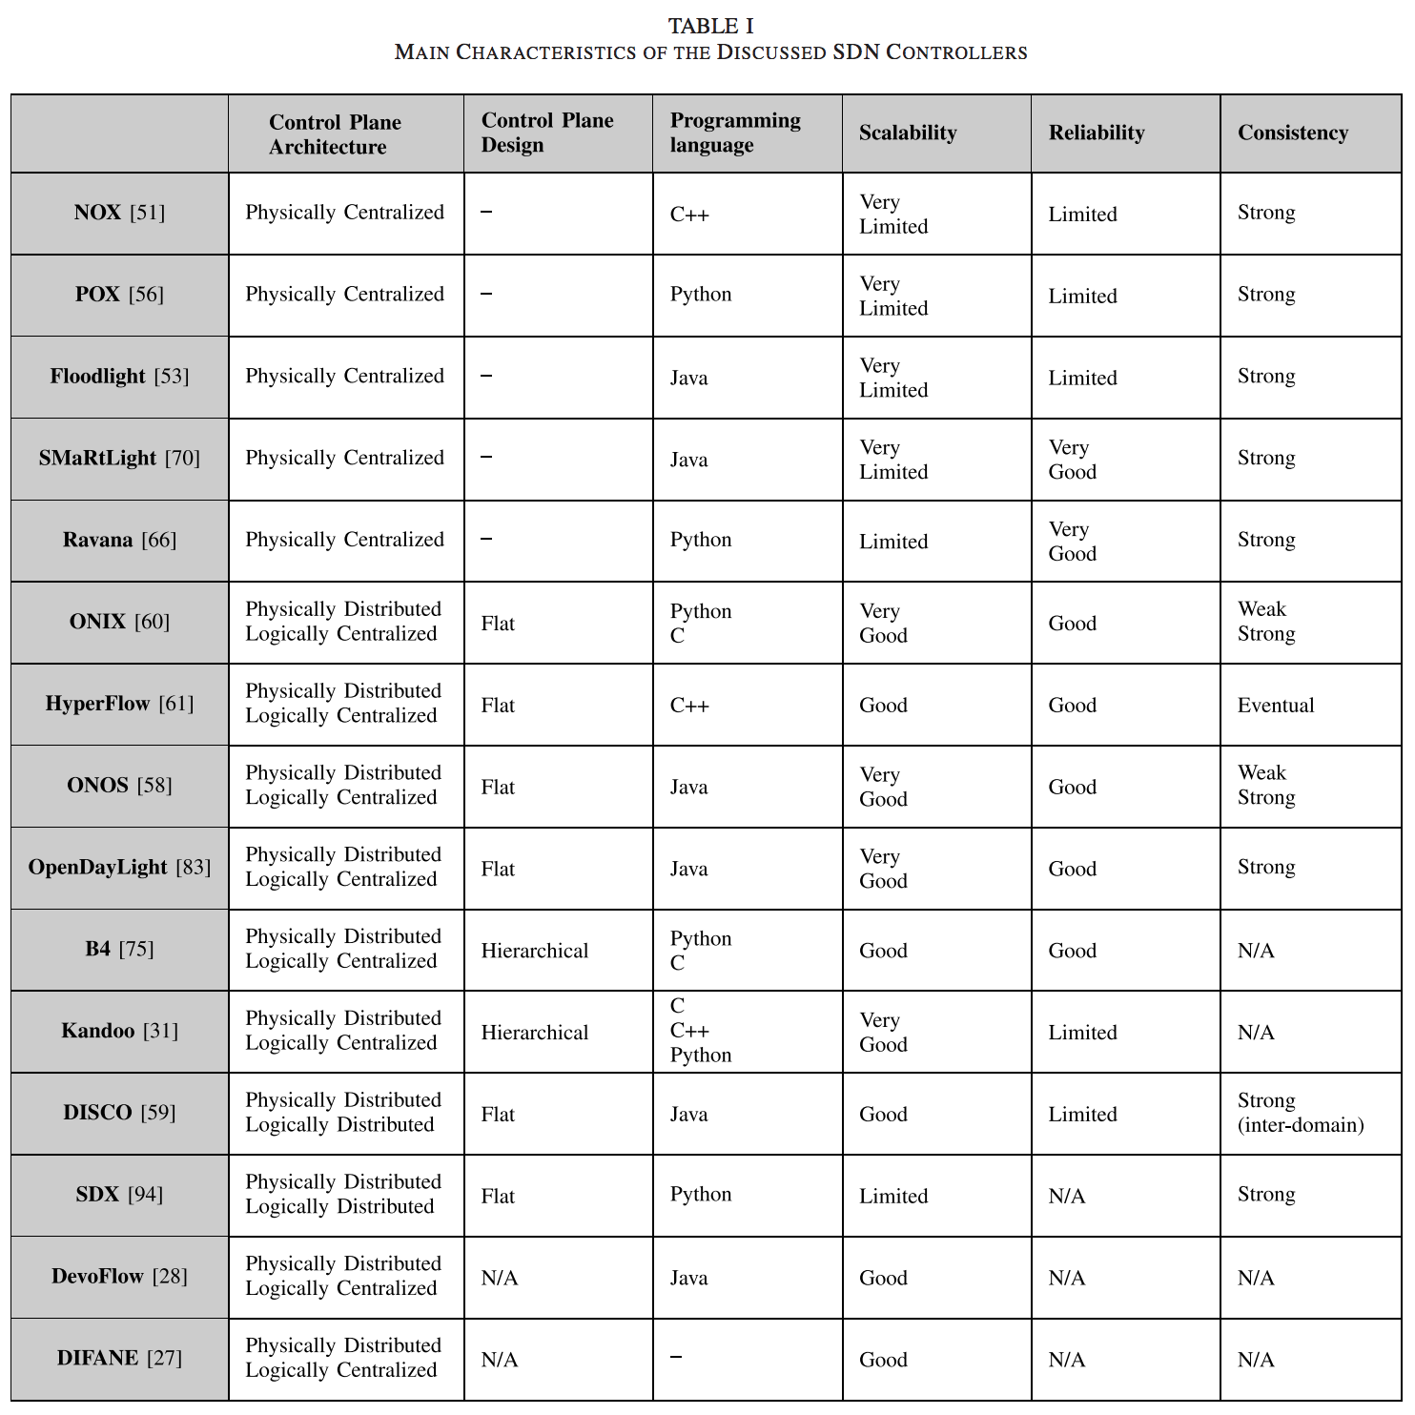
Summary and Future Perspectives
Scalability
Reliability
Consistency
Interoperability
Monitoring
Security
Other challenges
Notes:
Scalability
Problems
These concerns stem from decoupling of control and data planes as well as the the centralization of control logic in a software-based controller
As a network grows in size the centralized SDN controller becomes overloaded
As the network scales upwards communication delays between SDN controller and network switches may become high
Solutions
Extend responsibilities of control layer (takes modifications to OpenFlow switches)
Model control plane to mitigate scalability limitations (by a physically distributed control model, hierarchical control plane recommended)
Consistency needs to be considered as strong consistency could introduce new scalability issues
Reliability
Problems
Decoupling of control and data planes
In a centralized control plane, failure of the central controller could collapse network
Solutions
Logically centralized but physically distributed architecture alleviates issue
Control state redundancy and controller failover must be considered
Control state redundancy
State Machine Replication orders the events and updates the network concurrently, thus several machines contain a replica of the control state
Another option is primary and backup controllers the primary is updated, and the backups are updated periodically
Fault Tolerance
Master – slave (primary and backup)
Distributed where each is updated concurrently
Consistency
Distributed SDN controller platforms are affected most by this issue
CAP theorem claims it is generally impossible to simultaneously achieve consistency, high availability, and partition tolerance
Strong consistency in distributed SDN controllers results in latencies and overhead in the form of data access which can affect network availability and scalability
Eventual or weak consistency allows higher network availability but could cause inconsistent or incorrect application behavior
Overall, achieving consistency involves a tradeoff between policy enforcement and network performance
This article suggests a hybrid approach to these tradeoffs using dynamic consistency model selection
Interoperability
This applies to not only with legacy systems but also with disparate distributed SDN controllers
There is a lack of open standards for inter-controller communications
There are several barriers for the development of these standards
Monitoring
Network monitoring is needed to develop control and management applications in distributed SDN-based networks
There are trade-offs between network monitoring and data accuracy
Security
Having distributed SDN control leads to some security improvements and some new security concerns

Slide 4
Conclusion
Increase in SDN built on promises on the separation of concerns between network control logic and forwarding devices as well as the logical centralization of network intelligence
Physically centralized control architectures raised scalability and reliability concerns
This article looked at the existing SDN controller platforms
Scalability, reliability, consistency and interoperability are among the key competing challenges
This article suggests using the proposed SDN controller platforms and aggregating, merging, and learning from them to come to a common standard
Lastly, they propose more research and splitting of problem into two sub-areas
Controller placement
Knowledge sharing

